Slide 1
How to proceed?

Slide 2
Hard Skills

Slide 3
Where to go?
There are a lot of tools in our business; but tools are not important.
If you know the basics of computer engineering, you will learn them as you need.
Do NOT try to find someone to teach you how to use a tool; You are NOT an operator.
Do try to find someone to show you the way and keep you on track.
Considering these, here what you should try to learn more about:
Operating System
Network
Virtualization
Container & Container orchestration
Reverse Proxy
Databases
Version control
CI/CD
Visibility
IaC (Trafform, Ansible, Chef, Puppet, Helm, Kustomize)
Programming
Cloud
Notes:
Trafform: Provisioning
Ansible, Chef, Puppet: Configuration
Helm, Kustomize: K8S manifests

Slide 4
What else?
If you want to be a personal that employers counts on to do stuff and employees want to work with, you need more than what we discussed. You have to become a “linchpin”.
Read this book to understand more: “Linchpin: Are You Indispensable?” by Seth Godin.
To do so, you have to know a lot more; project management, people management, specifying processes and so on.

Slide 5
Soft Skills

Slide 6
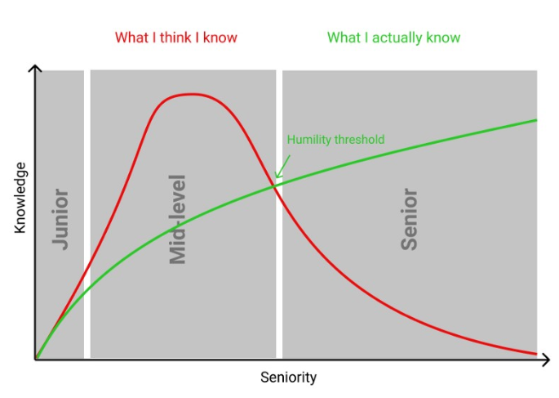
Seniority
Notes:
Knowledge is not just hard skills. Soft skills are much more important.
Why you may think you know more?
Dunning–Kruger effect & Johari window will help us to understand why.

Slide 7
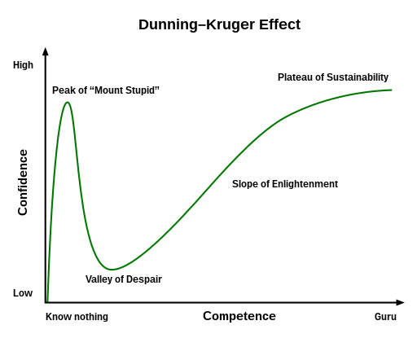
Dunning–Kruger effect
The Dunning–Kruger effect is a cognitive bias in which people with limited competence in a particular domain overestimate their abilities. Some researchers also include the opposite effect for high performers: their tendency to underestimate their skills.

Slide 8
Johari Window
Self
Known by self
Ask
Unknown by self
Known by Others
Open/Free area
Blind area
Shared discoveries
Tell
Others
Other’s Observation
Self Disclosure/Exposure
Unknown by Others
Hidden area
Unknown area
Self Discoveries
Notes:
A Johari window is a psychological tool created by Joseph Luft and Harry Ingham in 1955. It’s a simple and useful tool for understanding and training:
self-awareness
personal development
improving communications
interpersonal relationships
group dynamics
team development; and
inter group relationships
It is one of the few tools out there that has an emphasis on “soft skills” such as behaviour, empathy, co-operation, inter group development and interpersonal development. It’s a great model to use because of its simplicity and also because it can be applied in a variety of situations and environments.

Slide 9
One of the most important one
If you really don’t know something and someone ask you about it, say “I don’t know”, then if it’s important for your current job or your career or event it’s just interesting for you, ask him/her/them about it and then go search/read about it.

Slide 10
Glasser's choice theory
Choice theory posits that the behaviors we choose are central to our existence.
Our behavior (choices) is driven by five genetically driven needs in hierarchical order:
Survival
Love
Power
Freedom
Fun
Read this book to understand more: “Glasser's choice theory” by William Glasser, MD
This will help us to better understand our relationships and decision making.
No one can make us a successful or a failed person, since we can only pass or get information.

Slide 11
The Ten Axioms of Choice
The only person whose behavior we can control is ourselves.
All we can give another person is information.
All long-lasting psychological problems are relationship problems.
The problem relationship is always part of our present life.
What happened in the past has everything to do with who we are today, but we can only satisfy our basic needs right now and plan to continue satisfying them in the future.
We can only satisfy our needs by satisfying the pictures in our quality world.
All we do is behave.
All behavior is total behavior and is made up of four components: acting, thinking, feeling, and physiology.
All of our total behavior is chosen, but we only have direct control over the acting and thinking components. We can only control our feelings and physiology indirectly through how we choose to act and think.
All total behavior is designated by verbs and named by the part that is the most recognizable.

Slide 12
My struggle

Slide 13
My country, My heart
I don’t care who’s running our country
I don’t care if I don’t get what I deserve
I only care about my country, our country
Thousands of men and women gave their lives through out the history for us
I don’t let it go just because I don’t get what I deserve
Be friendly to everyone and try your best to help others
Don’t let yourself go to the media; Media are tools
The future is ours, I serve my country and my countryman forever
Remember that you may reach a conclusion that you are more effective someplace else (like professor Samii) which is not a bad thing or vice versa like Dr. Hessabi; they are both great men and we all love them

Slide 14
Last word
Enjoy your life and open your heart
Work hard
Gain everyone trust
Lose yourself to find yourself
Be an engineer, not an operator; so think and question anything you don’t understand and seek answer until you do

